Slide 1
Progress Report on
“Optimal Protection Coordination of Directional Overcurrent Relays Considering N-1 Contingency”
Submitted by:
Dipendra Shrestha (KCE075BEL018)
Poshan Bhandari (KCE075BEL027)
Pratigya Shrestha (KCE075BEL028)
Rabin Sapkota (KCE075BEL030)
Supervised by:
Saddam Bala

Slide 2
Overview
Introduction
Background
Problem Statement
Objectives
Scope
Methodology
Block Diagram
Sequence of Work
Data Collection
Definition and Calculation of parameters
Protection Coordination Optimization
Hybrid-GA implementation
Testing
Repetition of the process for N-1 Contingency
Work Progress
Problems faced and solution
Work to be completed

Slide 3
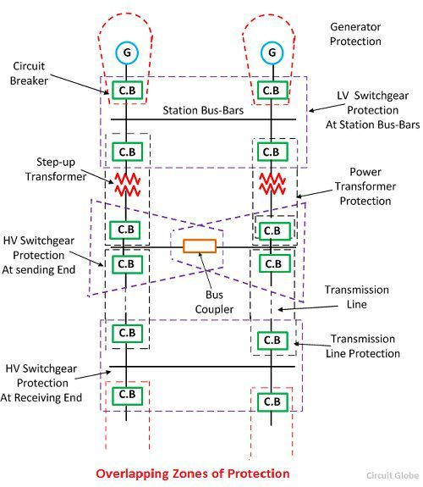
Introduction
Background
The protection coordination scheme specifies which relays serve as backups for the system.
The objective of a protection scheme is to keep the power system stable by isolating only the components that are under fault.
In integrated DG in power systems, Directional OCRs are used for protection coordination as the flow of short circuit current becomes bidirectional.
Contingencies cause various changes in topology in micro grids and islanded operation.
These changes in network configuration causes protection scheme to operate improperly.

Slide 4
Introduction
Problem Statement
The prior protection coordination cannot accommodate the change which occurs in the network configuration due to integrated DG(which can operate in both islanded and grid connected mode) and fails; this can cause random breakers to trip under fault conditions which is undesirable in a power system.

Slide 5
Introduction
Objectives
Main objectives:
To optimize protection coordination of Directional Overcurrent Relays’ parameters by using hybrid GA-LP.
Specific objectives :
To obtain data from load flow and short circuit analysis.
To obtain the optimum relays’ settings.
To examine the relay coordination under N-1 contingency .

Slide 6
Introduction
Scope:
To reduce exposure and isolate the problem.
To limit the duration of a problem/outage.
Minimize the damage of the components..
.
Enhancement of safety.

Slide 7
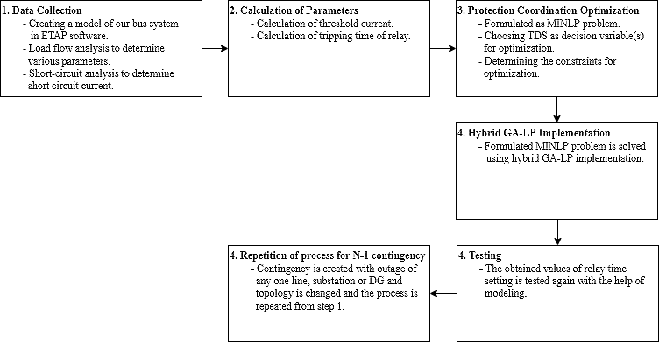
Methodology
Block diagram

Slide 8




Sequence of work
Methodology
Step 1
To perform load flow analysis and short circuit analysis
Step 2
To perform protection coordination.
Step 3
To find the optimized parameters of relay setting
Step 4
Perform the coordination for N-1 contingencies

Slide 9
Methodology
Data Collection
Data collection from IEEE standard bus.
Modelling of the bus using ETAP software.
Load-flow and Short-Circuit analysis.

Slide 10
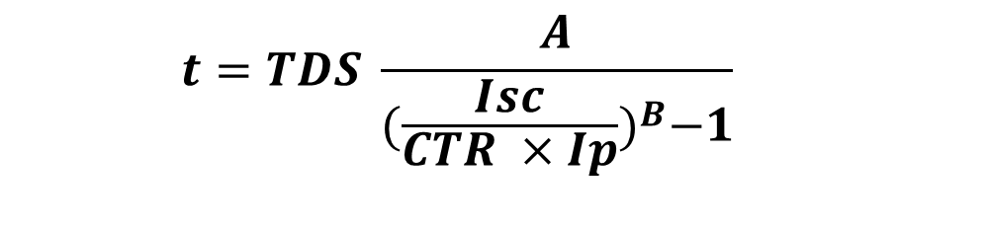
Methodology
Definition and Calculation of Parameters
Pickup value of current is set to 120% of rated current.
Threshold current is calculated as CTR * Ip.
Tripping time (t) is calculated by the following formula:
$$t=TDS \frac{A}{{(\frac{Isc}{CTR ×Ip})}^{B}−1}$$

Slide 11
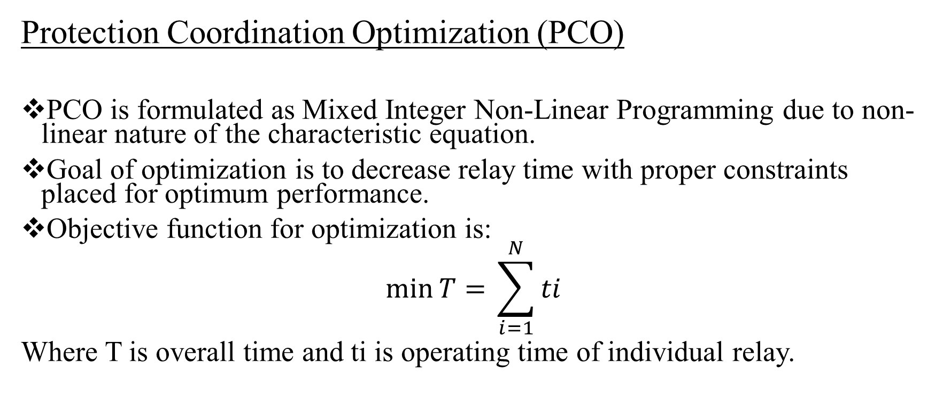
Methodology
Protection Coordination Optimization (PCO)
PCO is formulated as Mixed Integer Non-Linear Programming due to non-linear nature of the characteristic equation.
Goal of optimization is to decrease relay time with proper constraints placed for optimum performance.
Objective function for optimization is:
$$\min{T= }\sum_{i=1}^{N}{ti}$$
Where T is overall time and ti is operating time of individual relay.

Slide 12

Methodology
Protection Coordination Optimization (PCO) contd..
The constraint for optimization is given by:
$$TDSi−min≤TDS≤TDSi−max$$
$$tpbxcl −tppcl ≥CTI$$
where ,
p represents primary relay
bx represents corresponding backup relay.
The fault occurring at location I and network topology c.

Slide 13
Methodology
Hybrid-GA implementation
The formulated MINLP problem is solved using Hybrid-GA implementation.
By decoding information obtained from each chromosome of GA of length L=N₁*N₂ where N₁ is the total number of relays in a system and N₂ is the respective current tap settings, the protection coordination problem is converted into Linear Programming Problem with decision variable as TDS.
Based on the values of I_{p}, corresponding optimized TDS value is obtained which are further used to calculated tripping time of relays which sums up to minimum time of overall system which is our objective.

Slide 14
Methodology
Testing:
The obtained value of relays time setting are logged.
The logged data are then tested.

Slide 15
Methodology
Repetition of the process for N-1 contingency
The topology is changed by creating N-1 contingency.
The process is repeated for new model.
The process is repeated for all the combinations until no more combinations are left.

Slide 16
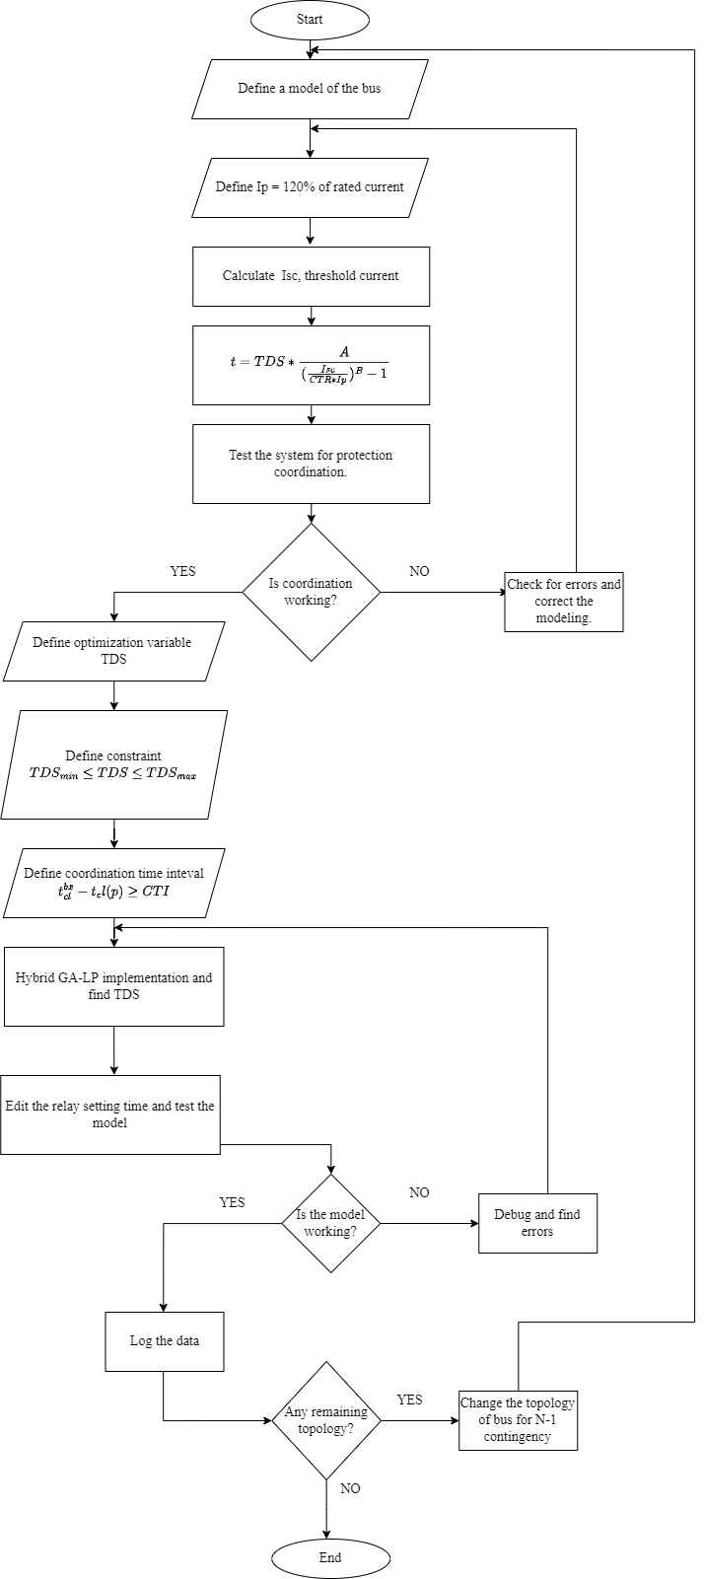
Methodology
Flowchart

Slide 17
Work Progress
Work Completed
Modeling of a 5 bus test system.
Load flow analysis and short circuit analysis.
Installation of protective devices.
Testing for Protection Coordination.

Slide 18
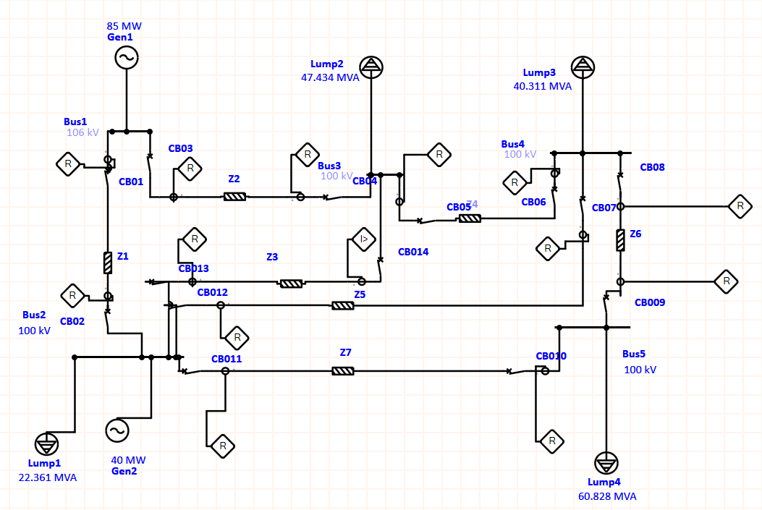
Work Progress
Modeling

Slide 19
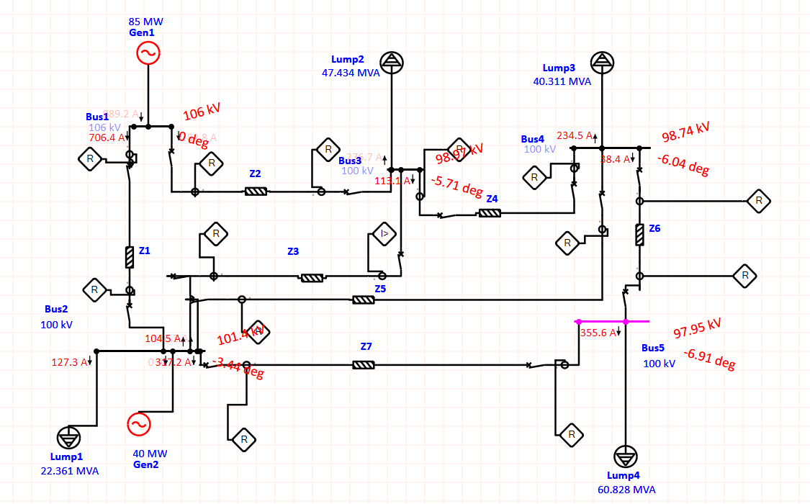
Work Progress
Load flow analysis

Slide 20
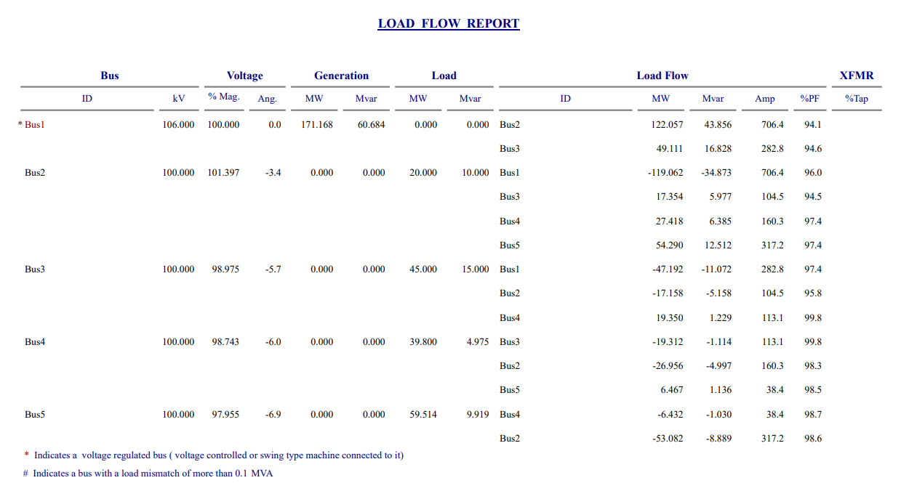
Work Progress
Load Flow Table

Slide 21
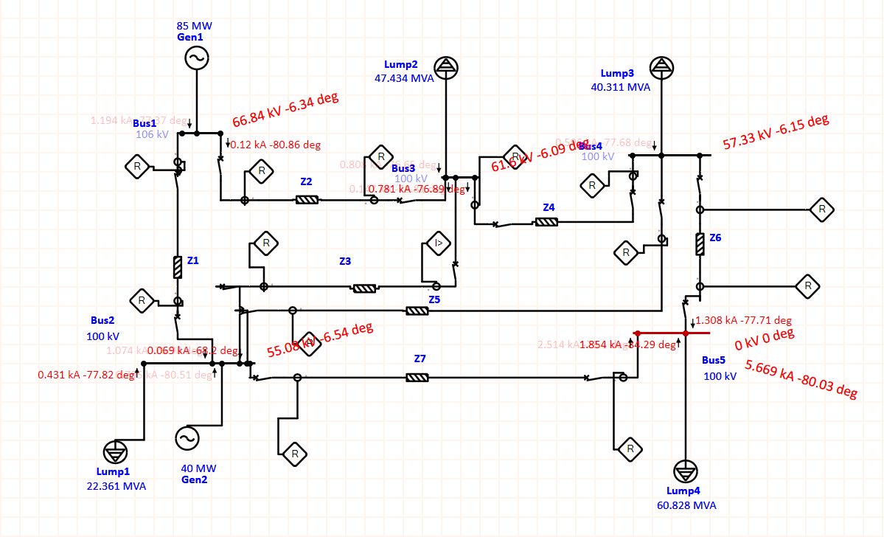
Work Progress
Short-Circuit Analysis

Slide 22
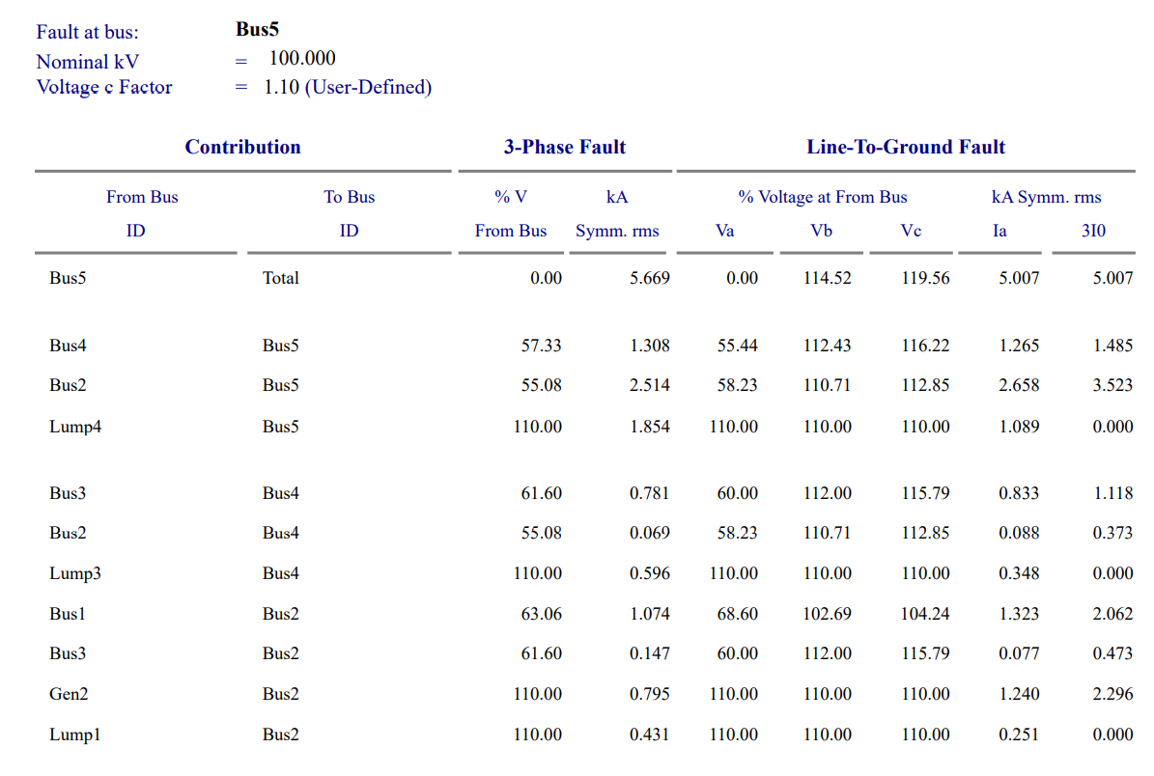
Work Progress
Short-Circuit Analysis

Slide 23
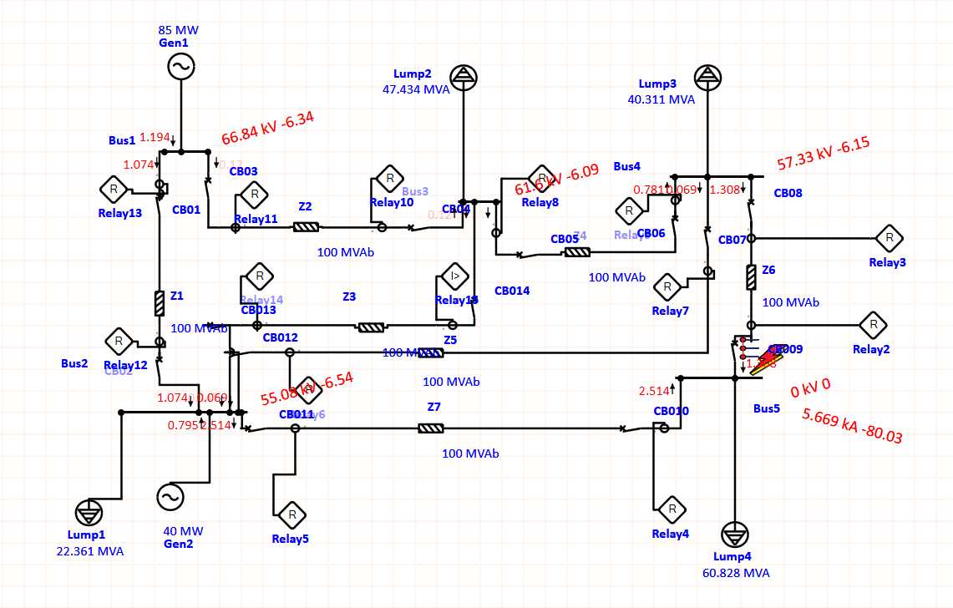
Work Progress
Testing the Model

Slide 24
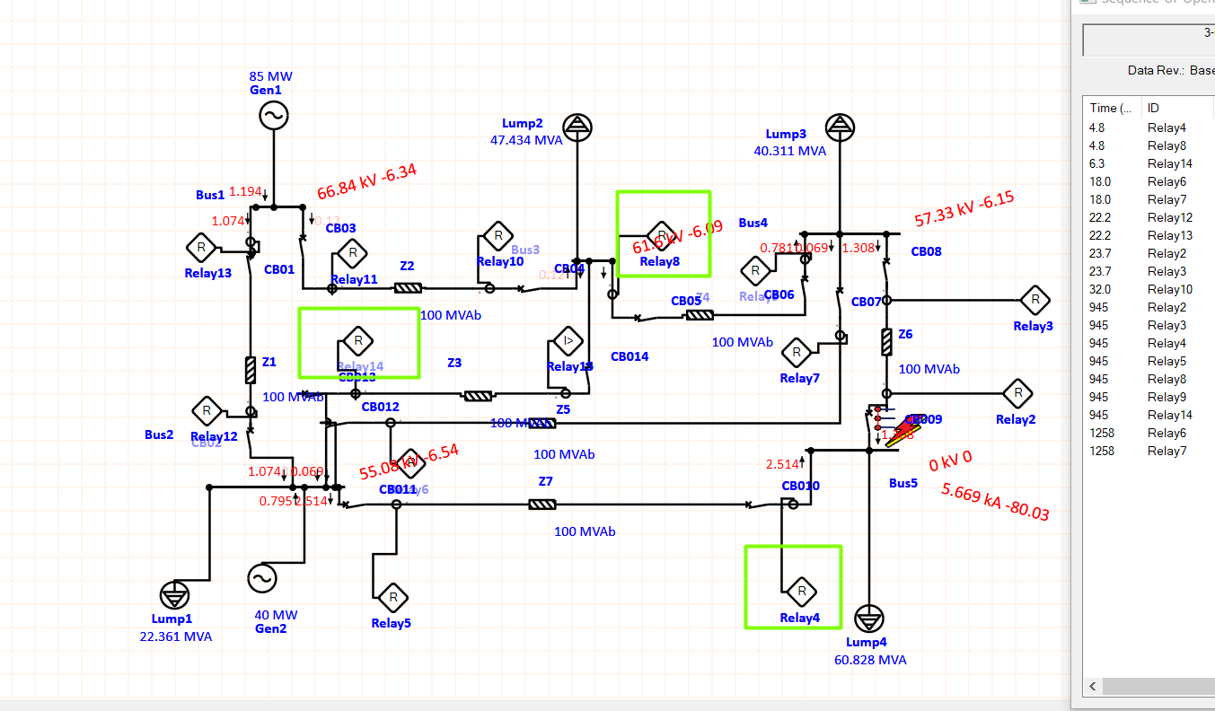
Work Progress
Protection Co-ordination problem
Random breakers tripping.
No coordination

Slide 25
Problems faced and solution
The data from the 5 bus system was done in ETAP which deviated from the standard IEEE 5 bus system.
This might have been due to the fact that ETAP solves the load flow in Newton Raphson which doesn’t converge efficiently for distribution system.
The modeling is proposed to be done through code in MATLAB too.

Slide 26
Works to be completed
To complete protection coordination in 5 bus system.
To apply N-1 contingency in 5 bus system.
To complete protection coordination through Hybrid GA-LP in the contingent topology.
Repeat the process for 14 bus system.

Slide 27
Thank you!!

